Slide 1
Tuning Python Applications Can Dramatically Increase Performance
Vasilij Litvinov
Software Engineer, Intel
Notes:
White text

Slide 2
Legal Disclaimer & Optimization Notice
INFORMATION IN THIS DOCUMENT IS PROVIDED “AS IS”. NO LICENSE, EXPRESS OR IMPLIED, BY ESTOPPEL OR OTHERWISE, TO ANY INTELLECTUAL PROPERTY RIGHTS IS GRANTED BY THIS DOCUMENT. INTEL ASSUMES NO LIABILITY WHATSOEVER AND INTEL DISCLAIMS ANY EXPRESS OR IMPLIED WARRANTY, RELATING TO THIS INFORMATION INCLUDING LIABILITY OR WARRANTIES RELATING TO FITNESS FOR A PARTICULAR PURPOSE, MERCHANTABILITY, OR INFRINGEMENT OF ANY PATENT, COPYRIGHT OR OTHER INTELLECTUAL PROPERTY RIGHT.
Software and workloads used in performance tests may have been optimized for performance only on Intel microprocessors. Performance tests, such as SYSmark and MobileMark, are measured using specific computer systems, components, software, operations and functions. Any change to any of those factors may cause the results to vary. You should consult other information and performance tests to assist you in fully evaluating your contemplated purchases, including the performance of that product when combined with other products.
Copyright © 2015, Intel Corporation. All rights reserved. Intel, Pentium, Xeon, Xeon Phi, Core, VTune, Cilk, and the Intel logo are trademarks of Intel Corporation in the U.S. and other countries.
Optimization Notice
Intel’s compilers may or may not optimize to the same degree for non-Intel microprocessors for optimizations that are not unique to Intel microprocessors. These optimizations include SSE2, SSE3, and SSSE3 instruction sets and other optimizations. Intel does not guarantee the availability, functionality, or effectiveness of any optimization on microprocessors not manufactured by Intel. Microprocessor-dependent optimizations in this product are intended for use with Intel microprocessors. Certain optimizations not specific to Intel microarchitecture are reserved for Intel microprocessors. Please refer to the applicable product User and Reference Guides for more information regarding the specific instruction sets covered by this notice. Notice revision #20110804

Slide 3
Agenda
Why do we need Python optimization?
How one finds the code to tune?
Overview of existing tools
An example
Prototype capabilities and comparison
Q & A
Notes:
3

Slide 4
Why do we need Python optimization?
Python is used to power wide range of software, including those where application performance matters
Some Python code may not scale well, but you won’t know it unless you give it enough workload to chew on
Sometimes you are just not happy with the speed of your code
All in all, there are times when you want to make your code run faster, be more responsive, (insert your favorite buzzword here).
So, you need to optimize (or tune) your code.
Notes:
Python is used to power wide range of software, including those where application performance matters
For example web server code, complex automation scripts (even build systems), scientific calculations, etc.
Python allows you to really quickly write some code which may not scale well, but you won’t know it unless you give it enough workload to chew on
Sometimes you’re just not happy with the speed of your code
Even worse, sometimes your customers are not happy with it ☹

Slide 5
How one finds the code to tune – measuring vs guessing
Hard stare = Often wrong
Logging = Analysis is tedious
Profile = Accurate, Easy
Notes:
“Easiest” way to find places to tune – “hard stare”
Easiest in terms of you don’t need any tools except code editor
Not the easiest one to execute, though – assumes you know how certain code constructs perform, which might not be the case
We’ll study one simple example further (a typical Python beginner mistake)
Obviously won’t work for even moderately large codebase – just too much information to grasp
“Middle-way” solution – “profiling-by-logging”
Done by making special version of source code augmented with timestamp logging
Involves looking at the logs trying to find out which place is slow
Right way – measure you program behavior, which is called “profiling”
Profiling is gathering some metrics on how your application works under certain workloads
In this talk we’d be focused on CPU hotspot profiling, i.e. searching for and tuning functions that consume a lot of CPU power
There’s possibility to profile things like waiting on a lock, memory consumption and so on.
For typical Python application CPU is usually the culprit, though, and even some memory consumption points could be identified by finding CPU hotspots (because allocating and freeing memory, especially in stuff like big Python sequence objects, takes significant amount of CPU usage).
One needs tools to profile an application, but the benefits of using them is usually worth the bother of getting hands on them

Slide 6
Not All Profilers Are Equal
There are different profiling techniques, for example:
Event-based
Example: built-in Python cProfile profiler
Instrumentation-based
Usually requires modifying the target application (source code, compiler support, etc.)
Example: line_profiler
Statistical
Accurate enough & less intrusive
Example: Intel® VTune Amplifier
Notes:
Event-based
Collect data on certain events, like function entry/exit, class load/unload, etc.
Built-in Python cProfile profiler (and sys.setprofile / sys.settrace API) are examples of event-based collections
Instrumentation-based
Modify target application to collect the data of itself
Could be done manually, or can have support in compiler, etc.
Could be done “on-the-fly”
Statistical
Collect data on regular intervals
Functions which are most executed should be at the top of “samples by function” distribution
Provide approximate results
Much less intrusive (don’t affect target application too much)
Not affected much by frequent calls to small functions
Profiling overhead dependency on the workload is much less

Slide 7
Most Profilers – High Overhead, No Line Info
Tool | Description | Platfo`rms | Profile level | Avg. overhead
cProfile (built-in) | Text interactive mode: “pstats” (built-in) GUI viewer: RunSnakeRun Open Source | Any | Function | 1.3x-5x
Python Tools | Visual Studio (2010+) Open Source | Windows | Function | ~2x
PyCharm | Not free cProfile/yappi based | Any | Function | 1.3x-5x (same as cProfile)
line_profiler | Pure Python Open Source Text-only viewer | Any | Line | Up to 10x or more
Notes:
cProfile – single-threaded (profiles multithreaded, but cannot tell threads apart; no callstacks)
Python Tools: great starting point, have certain limitations; “single-threaded” (like cProfile), have callstacks
VS being 32-bit only, and data being collected in memory limits the workload
PyCharm: provides quite nice GUI for cProfile and yappi
Yappi default use case includes modifying your source code; probably you could run it as a module (like cProfile); essentially is “cProfile made thread-aware”
Statprof: statistical, line-level; Unix-only; mostly single-threaded; text-only viewer, runnable from Python script or console; not developed (last update: 2012); need code modification

Slide 8
Python example to profile: demo.py
class Encoder:
CHAR_MAP = {'a': 'b', 'b': 'c'}
def __init__(self, input):
self.input = input
def process_slow(self):
result = ''
for ch in self.input:
result += self.CHAR_MAP.get(ch, ch)
return result
def process_fast(self):
result = []
for ch in self.input:
result.append(self.CHAR_MAP.get(ch, ch))
return ''.join(result)

Slide 9
Python sample to profile: run.py
import demo
import time
def slow_encode(input):
return demo.Encoder(input).process_slow()
def fast_encode(input):
return demo.Encoder(input).process_fast()
if __name__ == '__main__':
input = 'a' * 10000000 # 10 millions of 'a'
start = time.time()
s1 = slow_encode(input)
slow_stop = time.time()
print 'slow: %.2f sec' % (slow_stop - start)
s2 = fast_encode(input)
print 'fast: %.2f sec' % (time.time() - slow_stop)
No profiling overhead - a baseline for tools’ overhead comparison
slow: 9.15 sec = 1.00x
fast: 3.16 sec = 1.00x
Notes:
Time shown is the length of each function measured by the code itself (example of “logging measuring”).
This gives almost zero overhead, so it’s a baseline for comparing tools’ overhead.

Slide 10
cProfile + pstats UI example
> python -m cProfile -o run.prof run.py
> python -m pstats run.prof
run.prof% sort time run.prof% stats
Tue Jun 30 18:43:53 2015 run.prof
30000014 function calls in 15.617 seconds
Ordered by: internal time
ncalls tottime percall cumtime percall filename:lineno(function)
1 9.597 9.597 10.268 10.268 demo.py:6(process_slow)
1 3.850 3.850 5.302 5.302 demo.py:12(process_fast)
20000000 1.267 0.000 1.267 0.000 {method 'get' of 'dict' objects}
10000000 0.790 0.000 0.790 0.000 {method 'append' of 'list' objects}
1 0.066 0.066 0.066 0.066 {method 'join' of 'str' objects}
1 0.038 0.038 5.340 5.340 run.py:7(fast_encode)
1 0.009 0.009 15.617 15.617 run.py:1(<module>)
1 0.000 0.000 10.268 10.268 run.py:4(slow_encode)
slow: 10.27 sec = 1.12x
fast: 5.34 sec = 1.69x

Slide 11
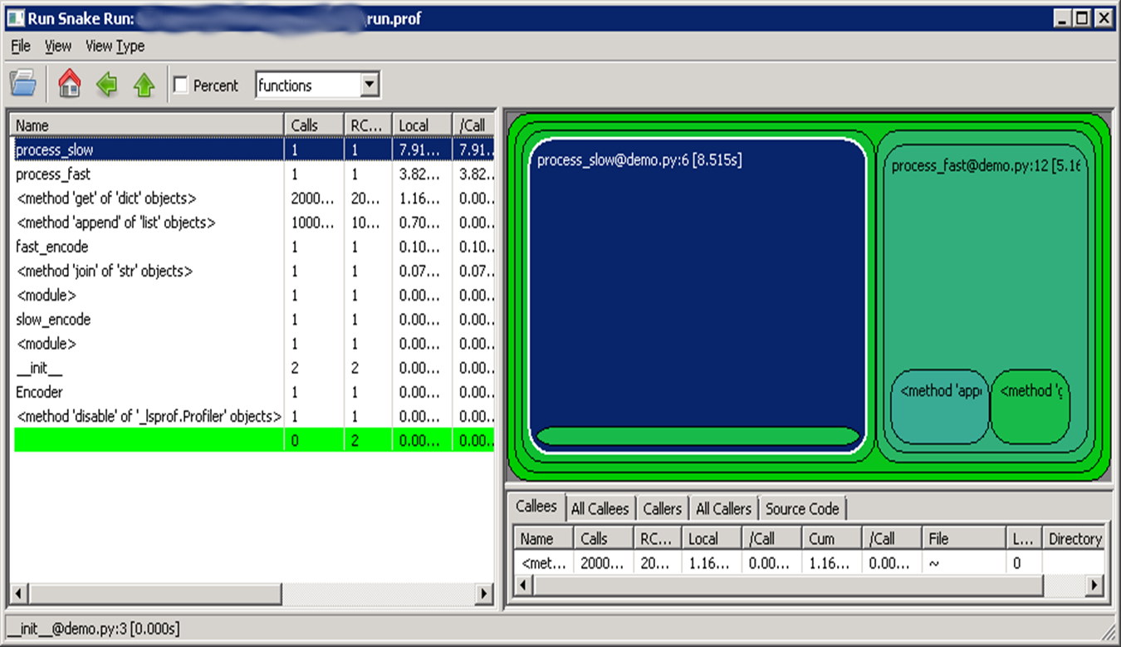
cProfile + RunSnakeRun

Slide 12
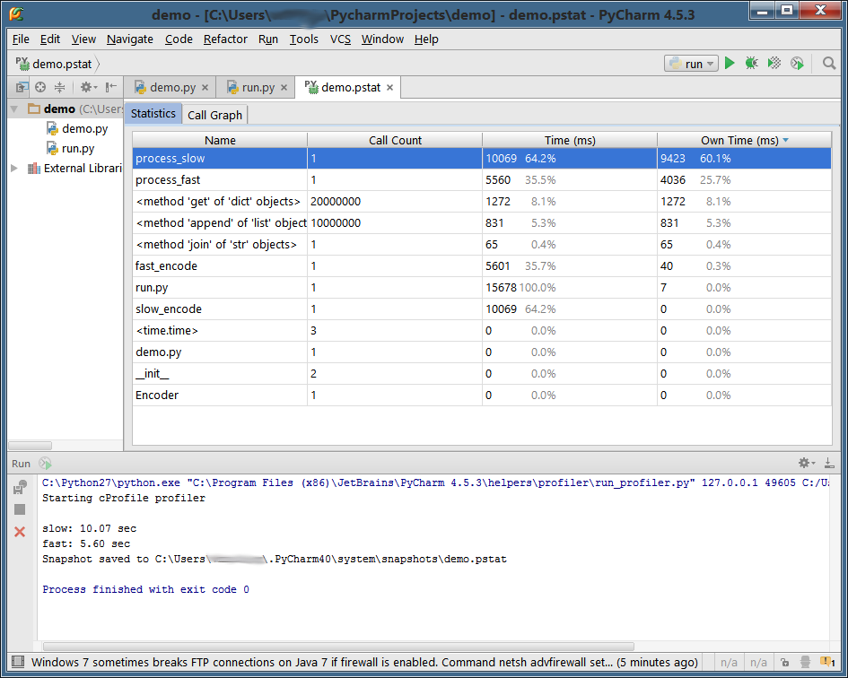
cProfile in PyCharm
slow: 10.07 sec = 1.10x
fast: 5.60 sec = 1.77x

Slide 13
line_profiler results
Total time: 18.095 s
File: demo_lp.py
Function: process_slow at line 6
Line # Hits Time Per Hit % Time Line Contents
==========================================================
6 @profile
7 def process_slow(self):
8 1 14 14.0 0.0 result = ''
9 10000001 10260548 1.0 23.3 for ch in self.input:
10 10000000 33814644 3.4 76.7 result += self.CHAR_MAP.get(...
11 1 4 4.0 0.0 return result
Total time: 16.8512 s
File: demo_lp.py
Function: process_fast at line 13
Line # Hits Time Per Hit % Time Line Contents
==========================================================
13 @profile
14 def process_fast(self):
15 1 7 7.0 0.0 result = []
16 10000001 13684785 1.4 33.3 for ch in self.input:
17 10000000 27048146 2.7 65.9 result.append(self.CHAR_MAP.get(...
18 1 312611 312611.0 0.8 return ''.join(result)
slow: 24.32 sec = 2.66x
fast: 25.37 sec = 8.03x

Slide 14
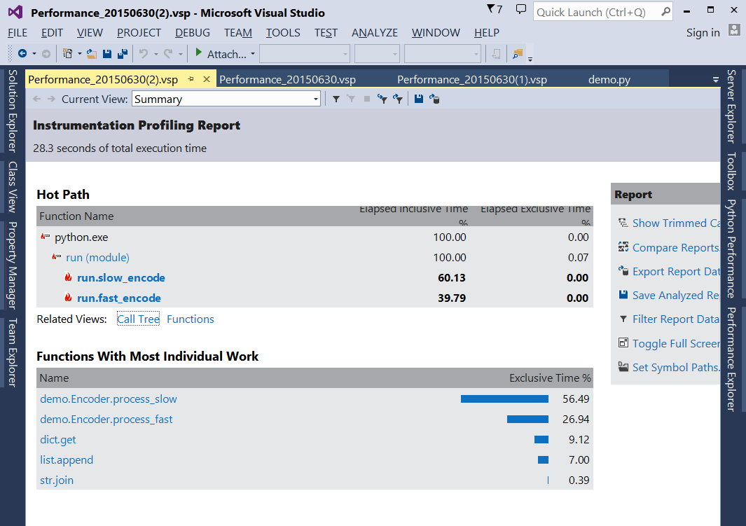
Python Tools GUI example
Note: Wallclock time (not CPU)
slow: 17.40 sec = 1.90x
fast: 12.08 sec = 3.82x
Notes:
Note: Python Tools seem to collect and show not CPU time consumption, but rather wallclock time

Slide 15
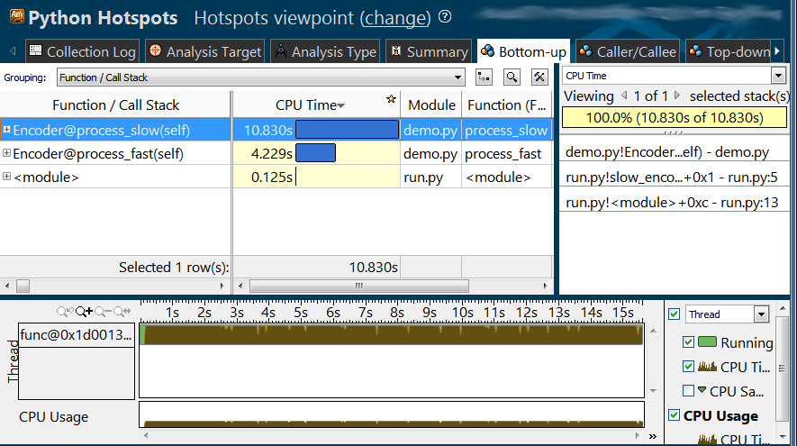
Prototype GUI example
slow: 11.24 sec = 1.23x
fast: 4.45 sec = 1.40x
Notes:
Note that with all the event-based profilers the overhead varies much more, and average overhead is higher.

Slide 16
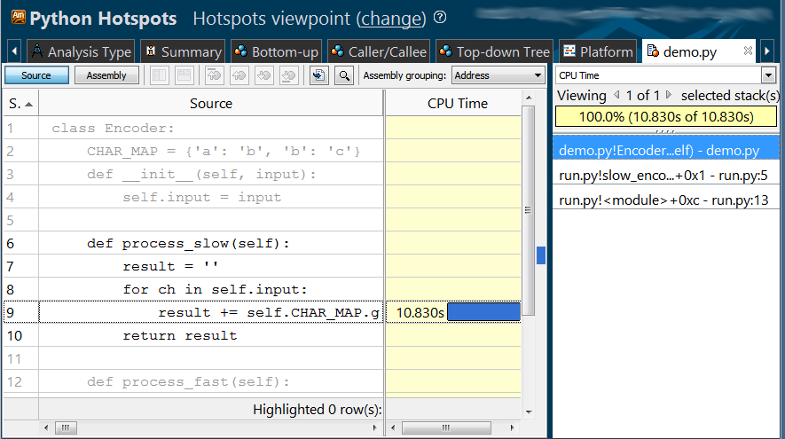
Prototype GUI – source view
Notes:
Line-level drill down: here’s the culprit of this function being slow.
String are immutable in Python, thus “+=“ operation actually translates to the following:
Allocate the memory for combined string
Copy original string, copy the added string
Deallocate memory of original string
Replace the original pointer with the copied one
Heap operations and copy are not blazing fast, thus approach slows a lot on big strings.
Overall, even if allocating speed is constant (if you have lots of heap available), the complexity is O(N²)
In the fast approach we actually do the allocation only once in the join, and string join operator is smart enough to first count the resulting string length (since it’s joining strings only), do the allocate once per function call, and do the copies once, so the complexity is about O(N)

Slide 17
Our Prototype: Accurate & Easy
Line-level profiling details
Uses sampling profiling technique
Average overhead ~1.1x-1.6x (on certain benchmarks)
Cross-platform
Windows and Linux
Python 32- and 64-bit; 2.7.x and 3.4.x branches
Rich Graphical UI
Supported workflows
Start application, wait for it to finish
Attach to application, profile for a bit, detach
Notes:
Line-level profiling details
Uses sampling profiling technique
Average overhead ~1.1x-1.6x - measured on Grand Unified Python Benchmark
Cross-platform
Windows and Linux
Python 32- and 64-bit
2.7.x and 3.4.x branches
Tested with 2.7.10 and 3.4.3
Remote collection via SSH supported
Rich UI with multithreaded support; zoom & filter; source drill-down
Supported workflows
Start application, wait for it to finish
Attach to application, profile for a bit, detach
Allows to profile code at all stages including most of Python code executed at initialization and shutting down of the interpreter (e.g. atexit-registered functions)

Slide 18
Low Overhead and Line-Level Info
Tool | Description | Platforms | Profile level | Avg. overhead
Our prototype | Rich GUI viewer | Windows Linux | Line | ~1.1-1.6x
cProfile (built-in) | Text interactive mode: “pstats” (built-in) GUI viewer: RunSnakeRun (Open Source) PyCharm | Any | Function | 1.3x-5x
Python Tools | Visual Studio (2010+) Open Source | Windows | Function | ~2x
line_profiler | Pure Python Open Source Text-only viewer | Any | Line | Up to 10x or more

Slide 19
We’ve Had Success Tuning Our Python Code
One widely-used web page in our internally set up Buildbot service: 3x speed up (from 90 seconds to 28)
Report generator – from 350 sec to <2 sec for 1MB log file
Distilled version was the base for demo.py
Internal SCons-based build system: several places sped up 2x or more
Loading all configs from scratch tuned from 6 minutes to 3 minutes

Slide 20
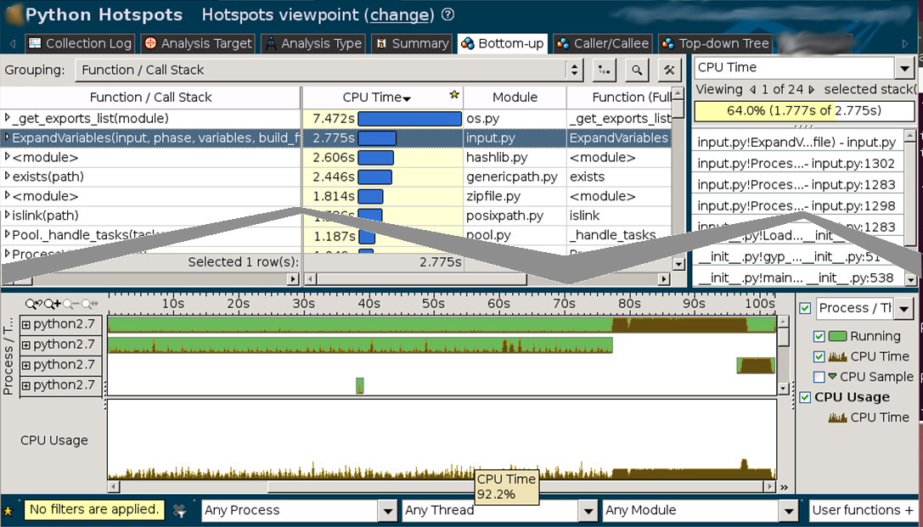
Profiling Chromium gyp script
http://dev.chromium.org/developers/how-tos/get-the-code

Slide 21
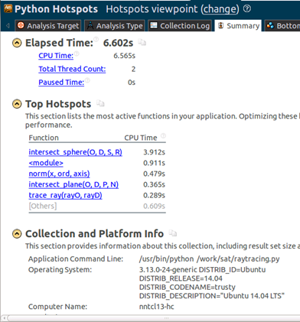
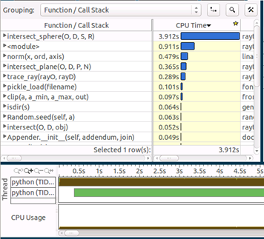
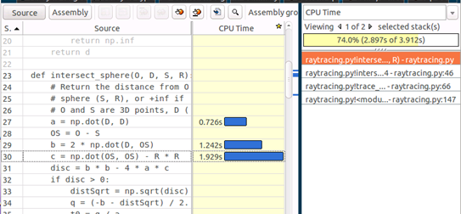
Profiling NumPy-based simple raytracing code
https://gist.github.com/rossant/6046463

Slide 22
Sign Up with Us to Give the Profiler a Try & Check out Intel® Software Development Tools
Visit us at our table or catch me during sprints
Technical Preview & Beta Participation – email us at scripting@intel.com
We’re making proof-of-concept work of Intel-accelerated Python (e.g. NumPy/SciPy, etc.). Sign up!
Check out Intel Developer Zone – software.intel.com
Check out Intel® Software Development tools
Qualify for Free Intel® Software Development tools

Slide 23
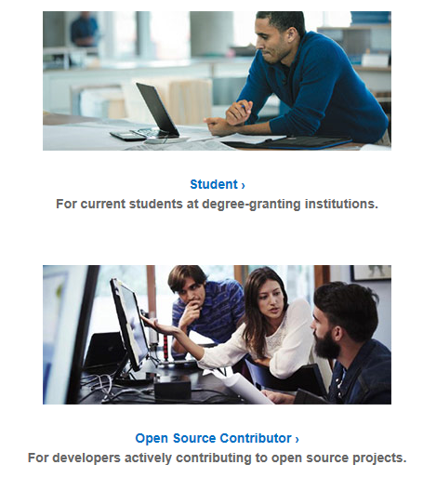
Free Intel® Software Development Tools
Intel Performance Libraries for academic research
Visit us at https://software.intel.com/en-us/qualify-for-free-software
Notes:
Intel Performance Libraries include Intel® MKL, Intel® TBB, Intel® IPP, Intel® MPI
The offering for academic researchers is worldwide.
The offering for academic researchers is for all research, even that which is funded by corporations/governments
We now offer tools for Fortran development to students (for use in classrooms) and educators.
Do not emphasize free libraries to audiences that are primarily commercial developers.
https://software.intel.com/en-us/qualify-for-free-software

Slide 24
Q & A
… and again:
For Tech Preview and Beta, drop us an email at scripting@intel.com
Check out free Intel® software – just google for “free intel tools” to see if you’re qualified

Slide 25
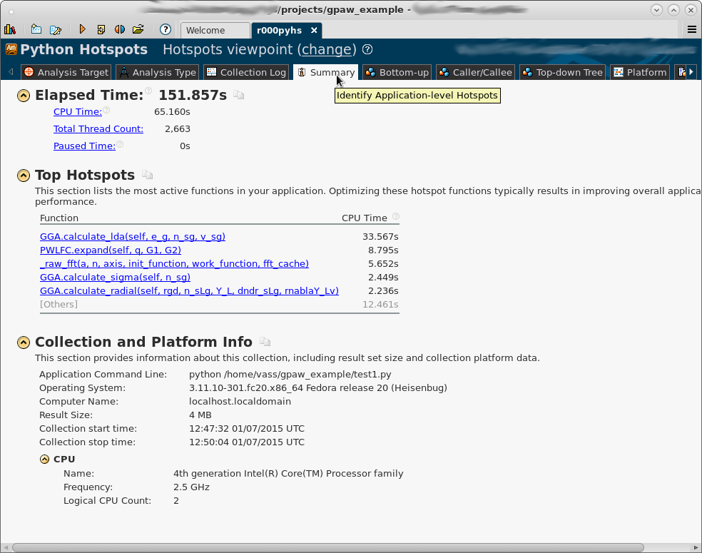
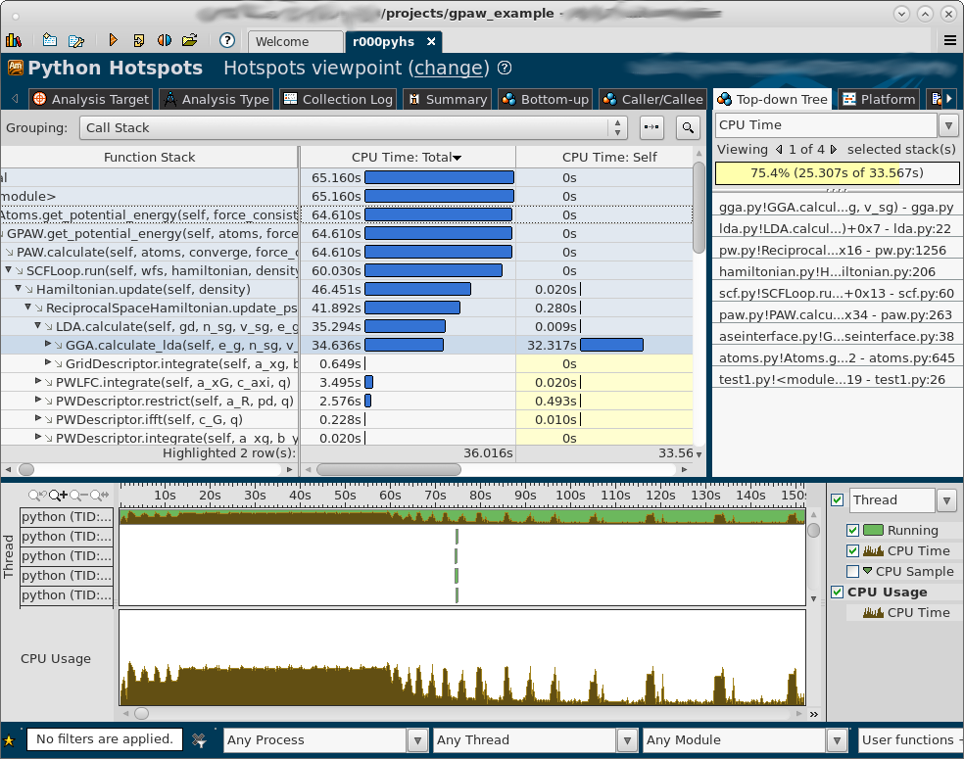
Profiling GPAW example – calculation of Hydrogen atom energies
https://wiki.fysik.dtu.dk/gpaw/tutorials/H2/atomization.html

Slide 26
Performance Starts Here!
You are a: | Products Available⁺⁺ | Support Model | Price
Commercial Developer or Academic Researcher | Intel® Parallel Studio XE (Compilers, Performance Libraries & Analyzers) | Intel® Premier Support | $699** - $2949**
Academic Researcher⁺ | Intel® Performance Libraries Intel® Math Kernel Library Intel® MPI Library Intel® Threading Building Blocks Intel® Integrated Performance Primitives | Forum only support | Free!
Student⁺ | Intel® Parallel Studio XE Cluster Edition
Educator⁺
Open Source Contributor⁺ | Intel® Parallel Studio XE Professional Edition
+Subject to qualification ⁺⁺OS Support varies by product **Single Seat Pricing

