Slide 1
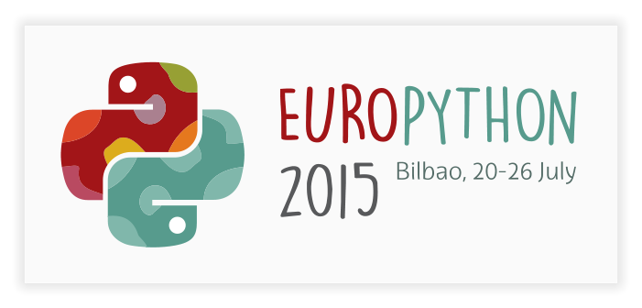
Mashing up py.test, coverage.py and ast.py to take TDD to a new level
Tibor Arpas
tibor@infinit.sk

Slide 2
Tibor Arpáš - about me
freelancer
but not “only”
only Python since 2008

Slide 3
About you

Slide 4
Users hate waiting
100 milliseconds
1 second
10 seconds

Slide 5
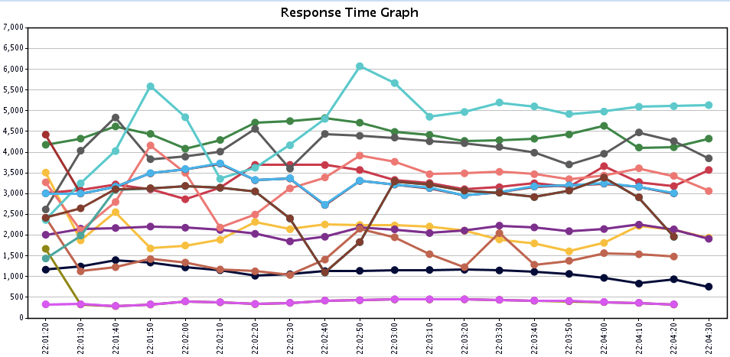
So computing adapts
big improvement in recent years

Slide 6
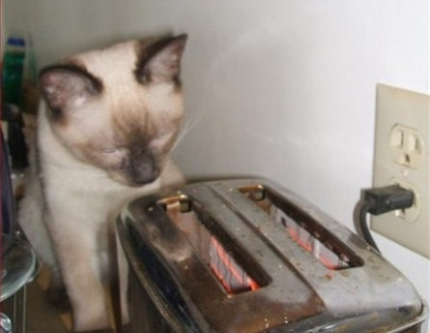
Executing test suite

Slide 8
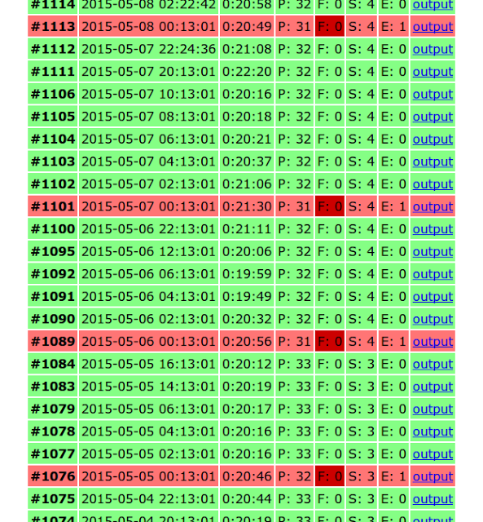
It’s easy to slip
and one bad commit can start a downward spiral
quality and effectivity decline

Slide 9
Broken test suite
error lifespan increase
punishment of the developers who are diligent

Slide 10
But …
how about running just affected tests?

Slide 11
Majority of code changes are local
waste to run the whole test suite each time

Slide 12
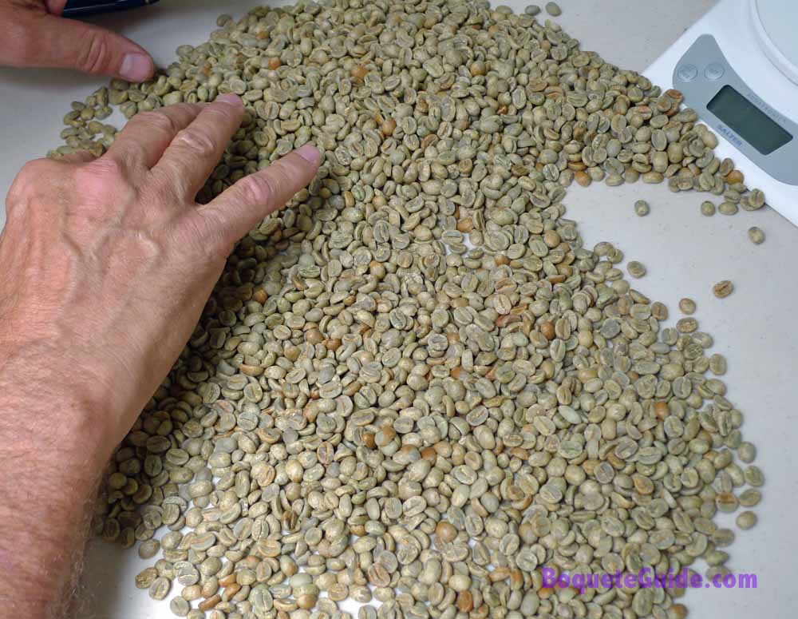
Tests hand picking
good luck beeing correct every time

Slide 13
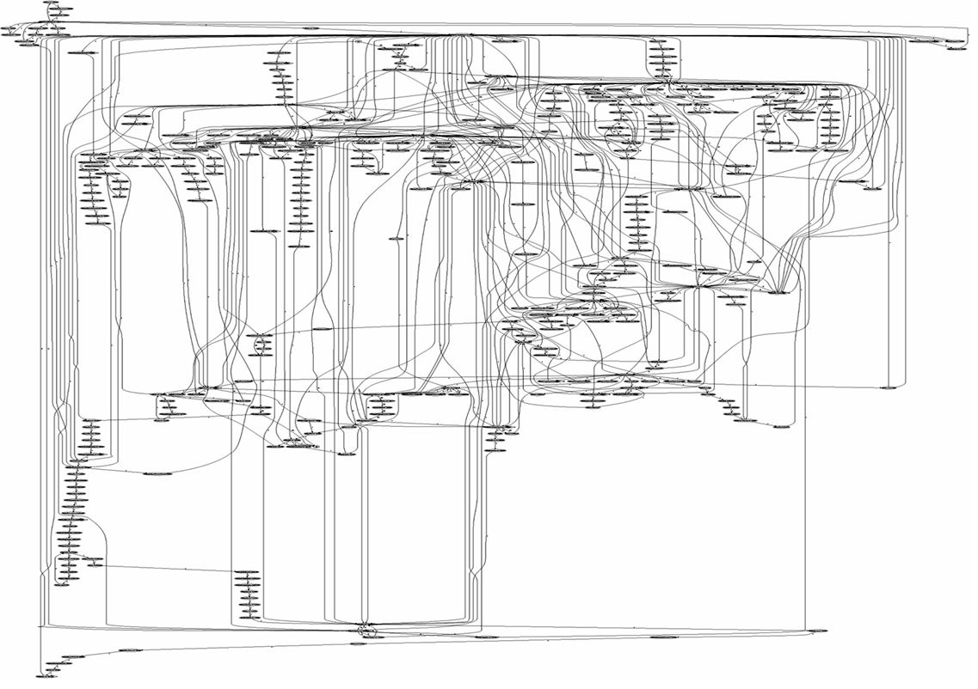
When the dependencies look like this

Slide 14
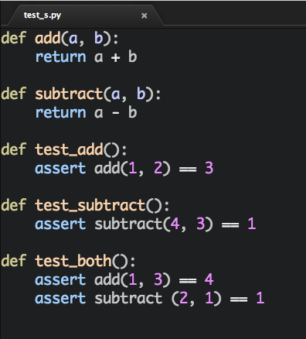
Example “project” with a test suite in one file

Slide 15
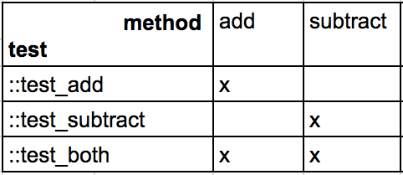
Dependencies

Slide 16
subtract vs. test_add

Slide 17
Dependencies

Slide 19
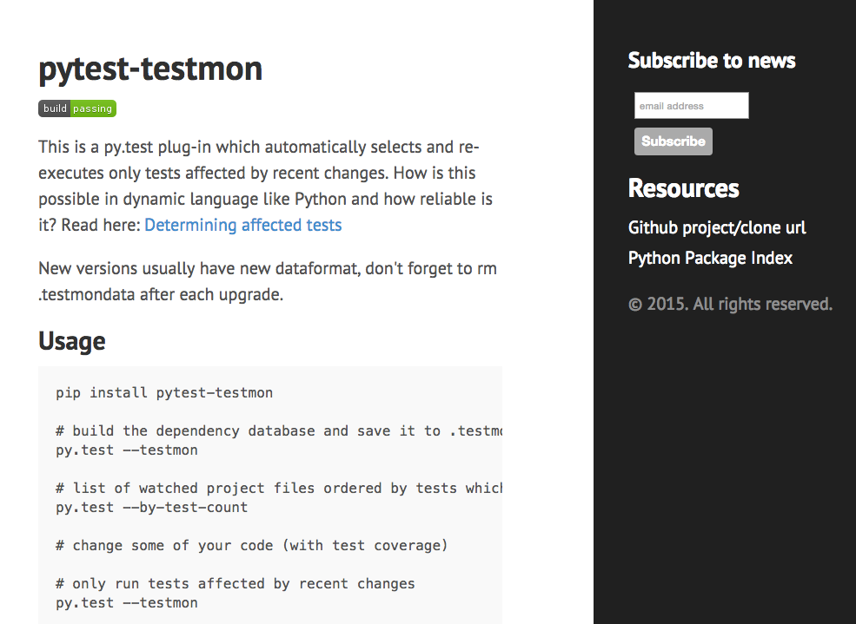
Idea transformed into a tool: testmon.org

Slide 20
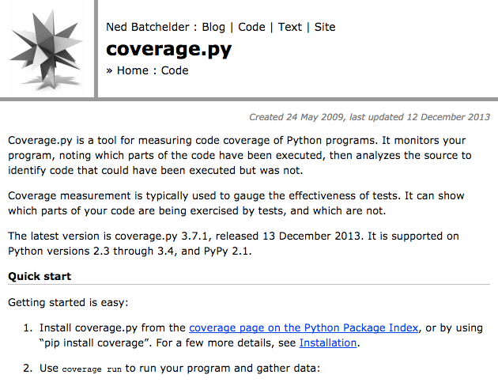
coverage.py
..
coverage.start()
code_to_track()
coverage.stop()
coverage.data
..

Slide 21
ast.py (standard library)
import ast
tree = ast.parse(source_code, file_name)
things that helped me to understand:
https://github.com/mitsuhiko/pyastutil -> codegen.py
ast.dump

Slide 22
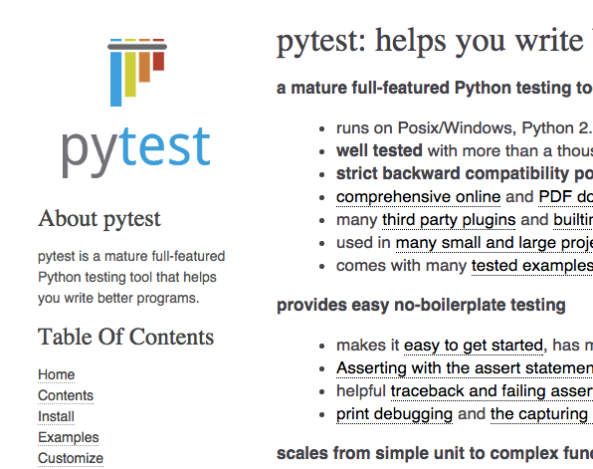
py.test plug-in
py.test’s plugin API is nice
just a couple of lines

Slide 23
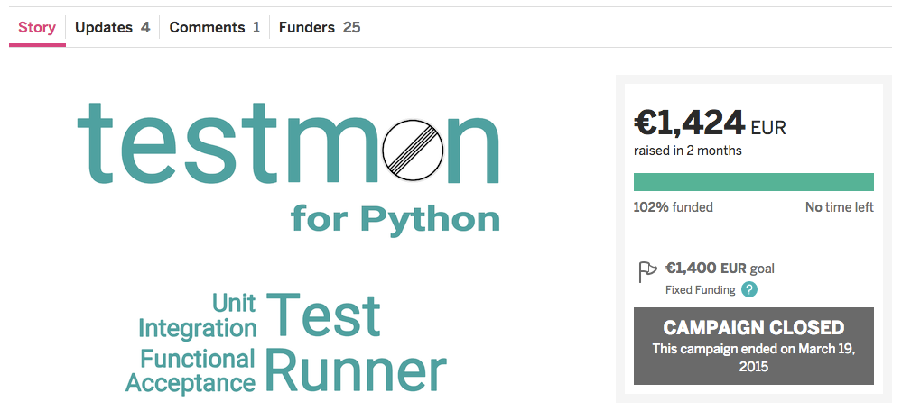
Interesting aspect - crowdfunding

Slide 24
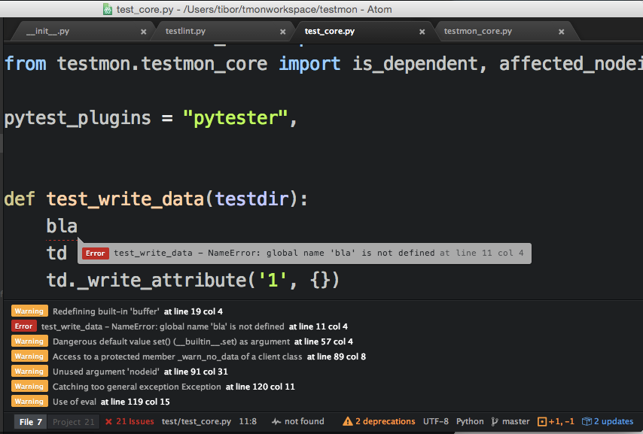

Slide 25
conclusion - testmon is awesome
use
give feedback
share

Slide 26
Contacts
Contacts again
Tibor
tibor@infinit.sk
Questions?

